Slide 1


TACTICAL COMBAT CASUALTY CARE COURSE
MODULE 02: MEDICAL EQUIPMENT
TCCC TIER 1
All Service Members
TCCC TIER 2
Combat Lifesaver
TCCC TIER 3
Combat Medic/Corpsman
TCCC TIER 4
Combat Paramedic/Provider

Slide 2




TACTICAL COMBAT CASUALTY CARE ROLE-BASED TRAINING SPECTRUM
ROLE 1 CARE
NONMEDICAL PERSONNEL
MEDICAL PERSONNEL
YOU ARE HERE
STANDARDIZED JOINT CURRICULUM
2

Slide 3






1 x TERMINAL LEARNING OBJECTIVES
03 Describe the use of individual medical equipment components in accordance with CoTCCC Guidelines.
  Describe the use of a first aid kit in accordance with Service policy. (ASM T2)
  Identify the contents of an individual Joint First Aid Kit (JFAK), and/or other Service-specific first aid kits. (ASM T2:E6)
  Describe the general maintenance and resupply procedures for trauma materials in a first aid kit in accordance with Service guidelines. (ASM T2:E7)
  Identify the contents of a combat lifesaver kit and/or other Service-specific first aid kits. (CLS T3:E12)
  Describe the use of components of a combat lifesaver kit in accordance with Service policy. (CLS T3:E13)
  Identify the contents of a medic/corpsman aid bag and/or other Service-specific first aid kits.
  Describe the use of a medic/corpsman aid bag, in accordance with Service policy.
7 x ENABLING LEARNING OBJECTIVES
= Terminal Learning Objectives = Cognitive ELOs = Performance ELOs
#
3

Slide 4
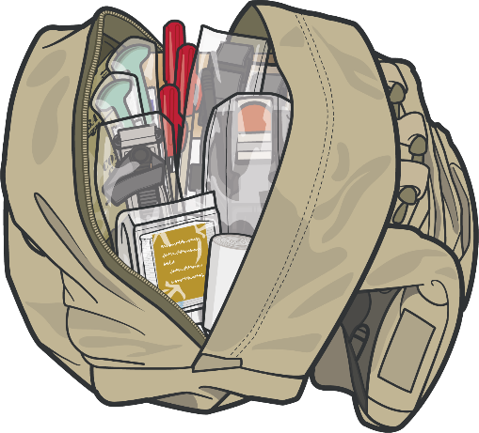
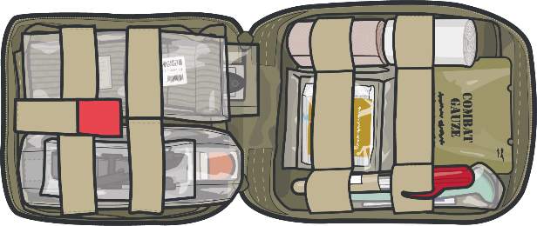

FIRST AID KITS
WHAT DO I TAKE?
INDIVIDUAL
Joint First Aid Kit (JFAK)
COMBAT LIFESAVER BAG
CLS Bag
Unit Standard Operating Procedures (SOPs) and individual responder capabilities/scope of care will determine what is carried in the First Aid Kits.

Slide 5
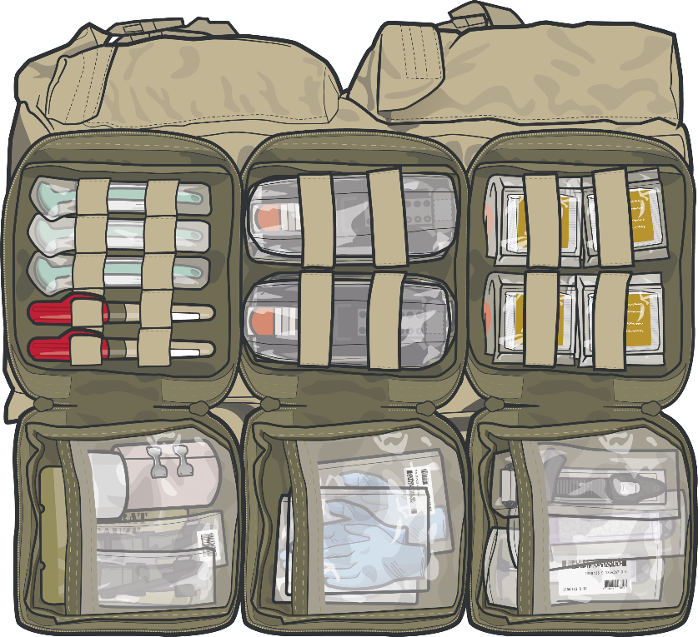
MEDICAL SUPPLIES
YOU WILL NEED TO PROVIDE AID AND SAVE LIVES
INDIVIDUAL
Joint First Aid Kit (JFAK)
COMBAT LIFESAVER BAG
CLS Bag
COMBAT MEDIC/ CORPSMAN AID BAG
CMC Aid Bag

Slide 6

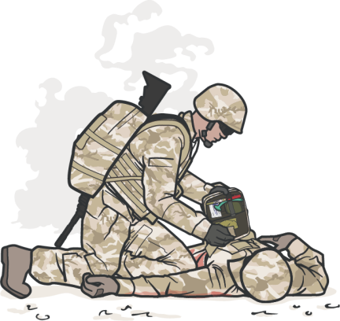

JFAK CONTENT AND CAPABILITIES
Items included in this kit will be able to treat the following:
P
_{A} Combat wound medication pack
W S
Other:
M
A R C H
Tourniquet, hemostatic gauze, and pressure bandages
Combat wound medication pack
Nasopharyngeal airway
Chest seal and NDC 10-14 Gauge 3.25” Needle Catheter (Service Specific)
Gauze and rigid eye shield
INDIVIDUAL
JFAK
ALWAYS use the casualty's JFAK first
DD Form 1380 and a marker

Slide 7
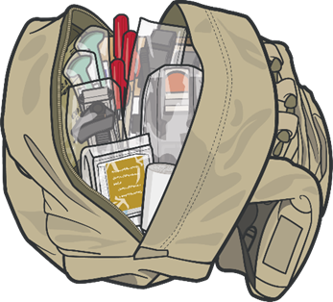



COMBAT LIFESAVER BAG CONTENT AND CAPABILITIES
Items included in this kit will be able to treat the following:
Tourniquets, hemostatic gauze, and pressure bandages
P
_{A} Combat wound medication pack
W S
Other:
M
A R C H
Combat wound medication pack
Nasopharyngeal airway
Vented Chest Seal, Bag Valve Mask, and NDC 10-14 Gauge 3.25” Needle Catheter
Gauze and rigid eye shield
BUDDY AID
Combat Lifesaver Bag
Gauze and Elastic bandage
Splinting material, cravats, and elastic wraps
Active/Passive Hypothermia Kits/Blankets and MACE2
DD Form 1380 and MEDEVAC Card

Slide 8

COMBAT MEDIC/CORPSMAN CONTENT AND CAPABILITIES
Items included in this kit will be able to treat the following:
M
A R
C H
Tourniquet, hemostatic gauze, pressure bandage, junctional tourniquet, X-stat, and wound closure device
Nasopharyngeal airway, extraglottic airway, cricothyroidotomy kits, and suction devices
Bag Valve Mask, vented chest seals, NDC 10-14 Gauge 3.25” Needle Catheter
ADVANCED TCCC CARE
Medic/Corpsman Aid Bag
Pelvic compression devices, Intravenous (IV) and Intraosseous (IO) access kits, IV fluids, EldonCard™, tranexamic acid (TXA), blood products, and Calcium
Active/Passive Hypothermia Kits/Blankets, IV fluid warmers, and MACE2
Stock this bag in accordance with your SOPs/Protocols

Slide 9
COMBAT MEDIC/CORPSMAN CONTENT AND CAPABILITIES (cont.)
Items included in this kit will be able to treat the following:
P
A W S
Other: DD Form 1380, MEDEVAC Card, Mission/Unit
Pain medications, extra combat wound medication packs
Antibiotics, extra combat wound medication packs
Gauze, elastic wrap, rigid eye shields
ADVANCED TCCC CARE
Medic/Corpsman Aid Bag
Malleable splints, rigid splints, cravats, and elastic wraps
Stock this bag in accordance with your SOP/Protocols
specific equipment

Slide 10
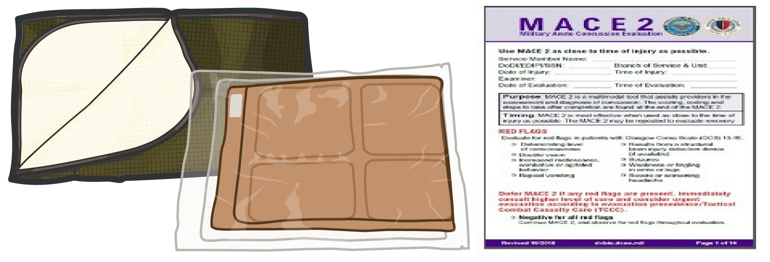

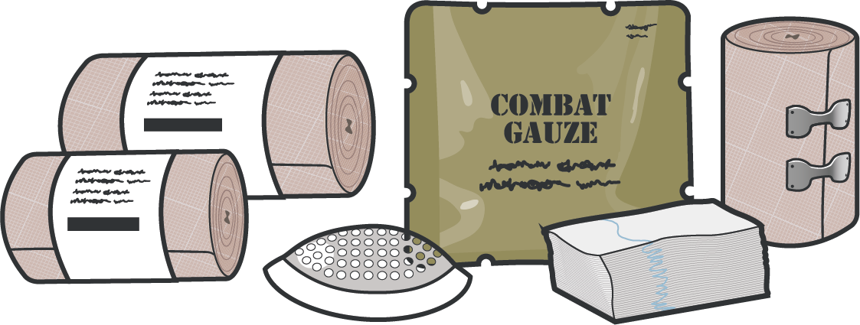
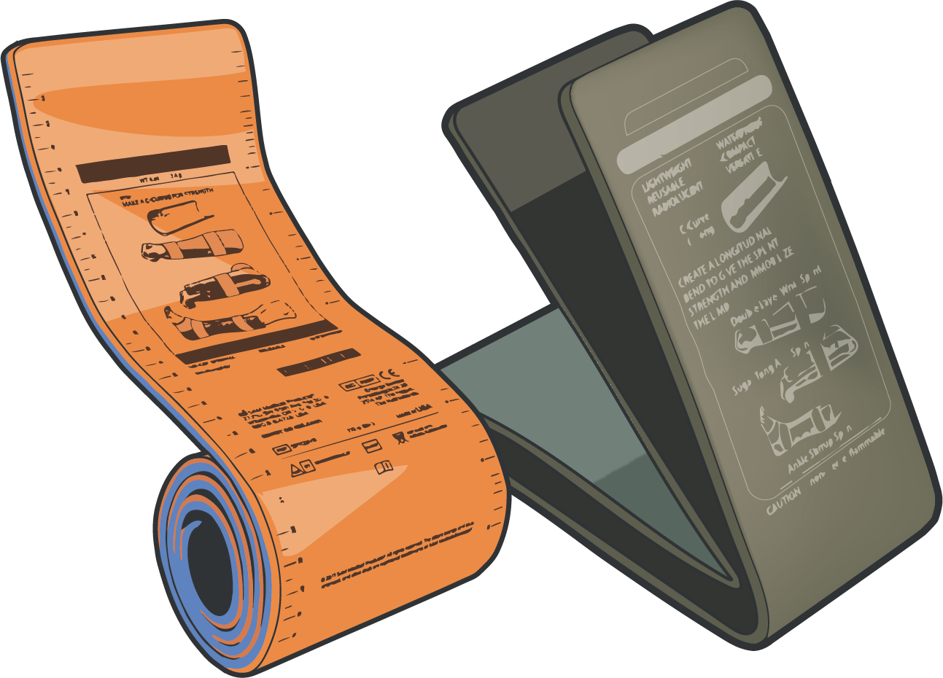
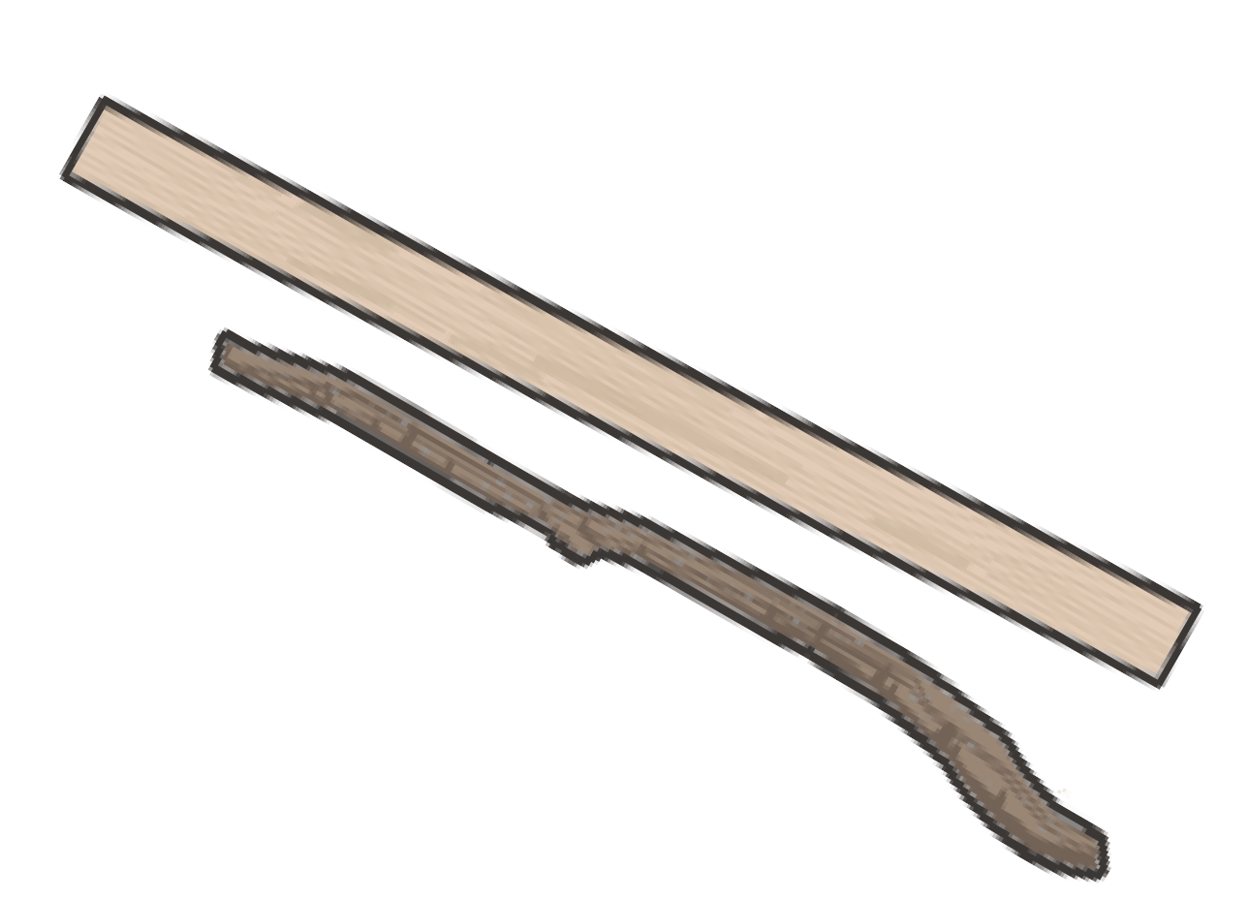

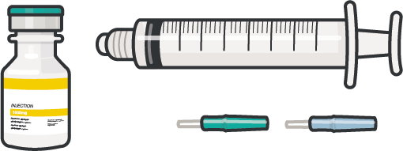

M
MASSIVE HEMORRHAGE
A
AIRWAY
R
RESPIRATIONS
C
CIRCULATION
H
HYPOTHERMIA/ HEAD INJURY
P
PAIN
A
ANTIBIOTICS
W
WOUNDS
S
SPLINTING

Slide 11
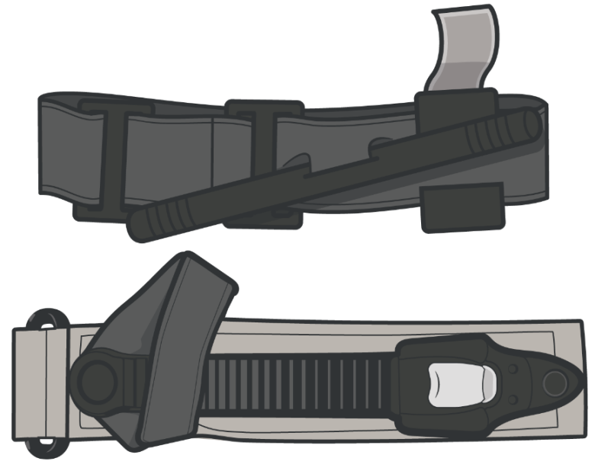
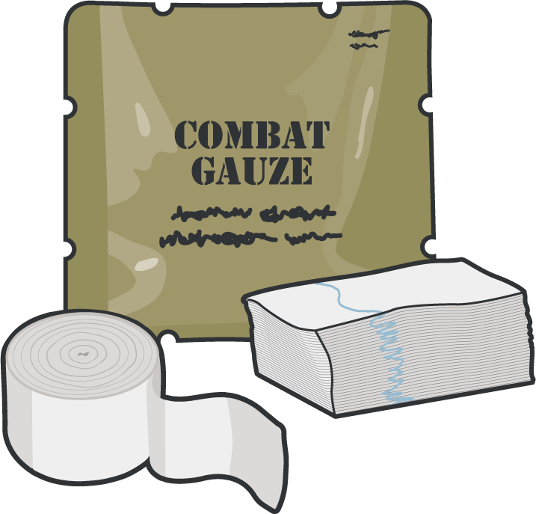
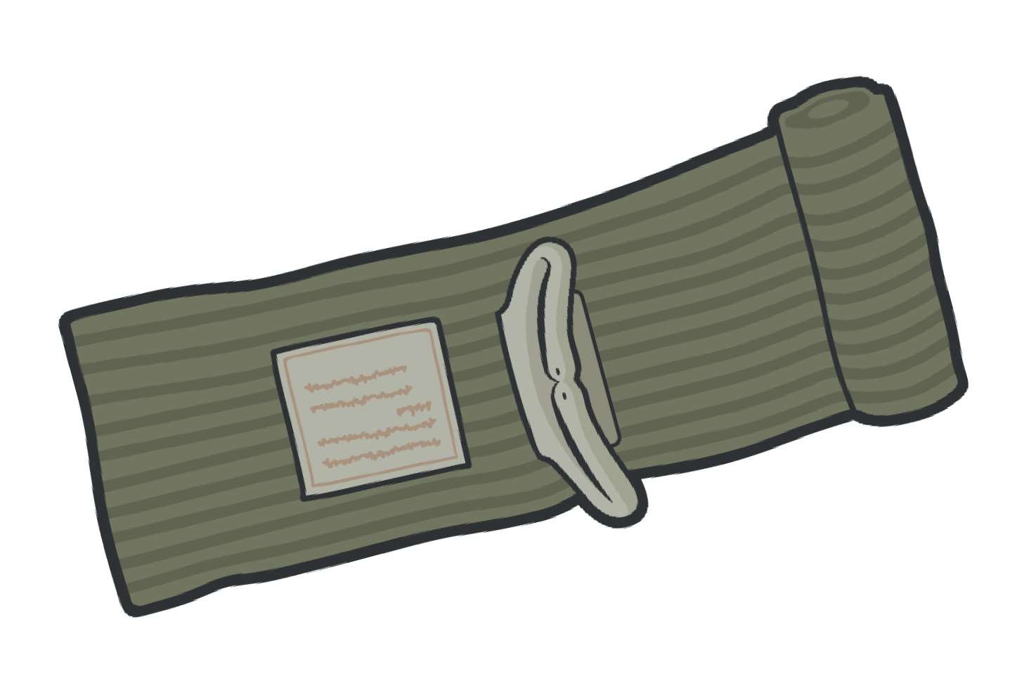
_{M} MASSIVE HEMORRHAGE EQUIPMENT
TOURNIQUET
CoTCCC-recommended and is used to control massive or severe hemorrhage of an extremity
HEMOSTATIC GAUZE
CoTCCC-recommended gauze, contains a chemical that bonds to another chemical in blood and causes clots to form at the source of bleeding
PRESSURE BANDAGE
Elastic bandage used as a pressure dressing and/or standard dressing

Slide 12
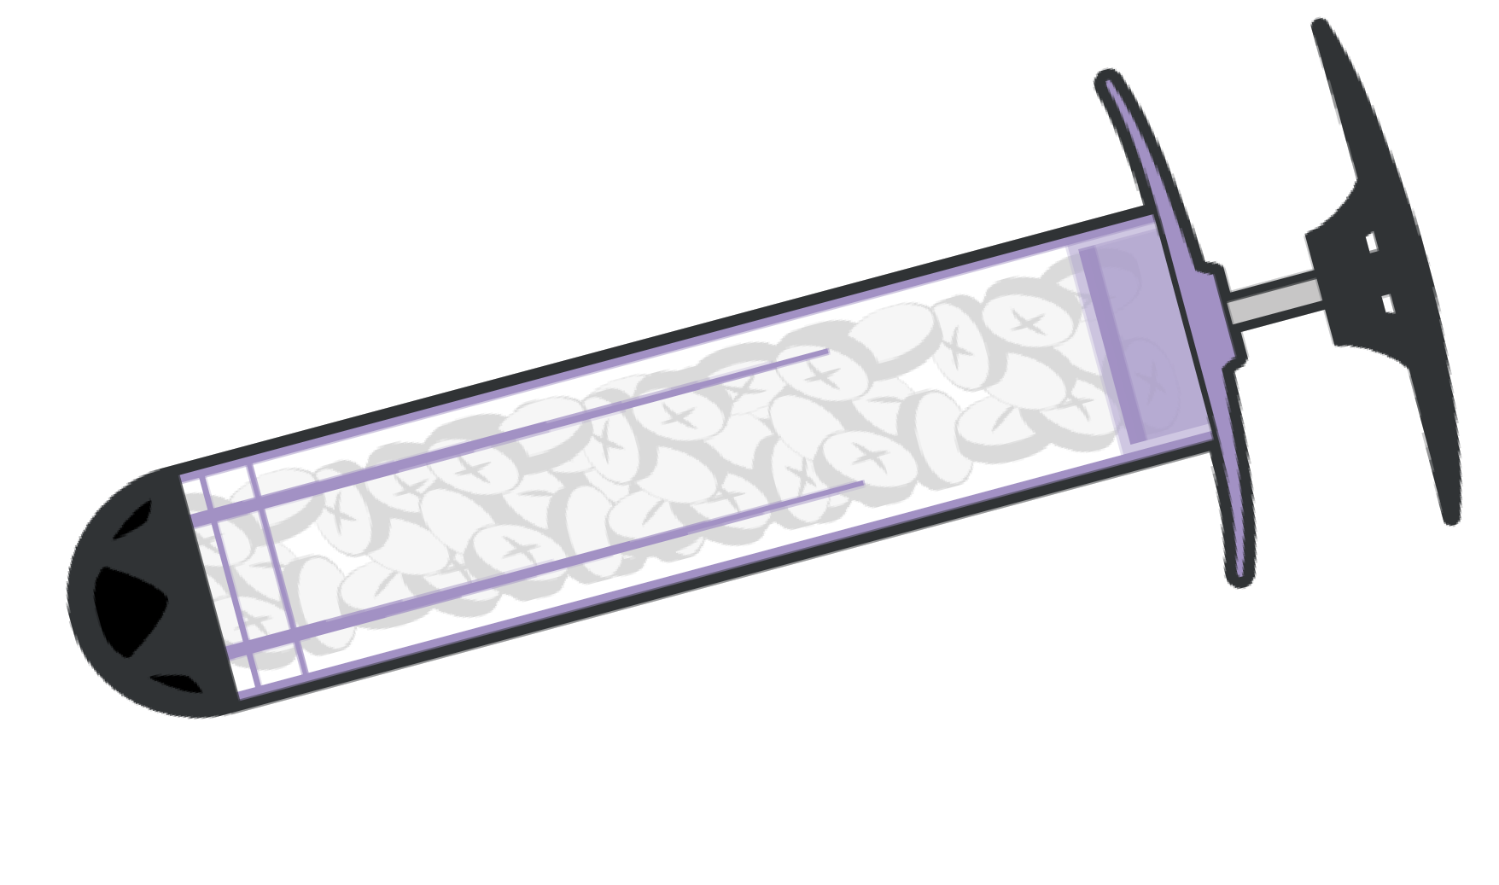

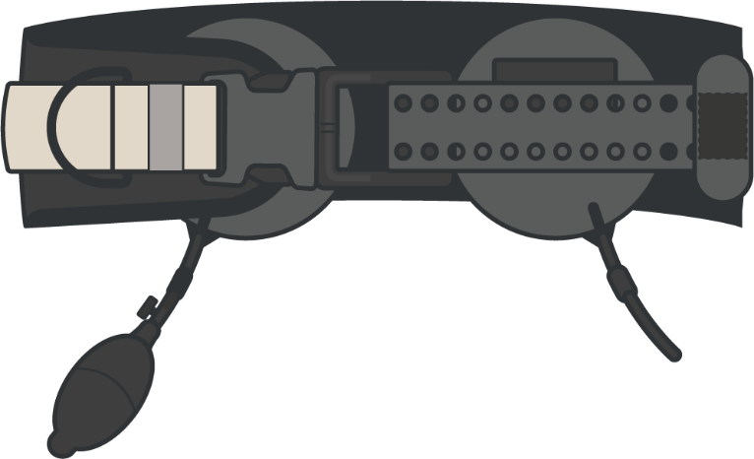
_{M} MASSIVE HEMORRHAGE EQUIPMENT
(cont.)
JUNCTIONAL TOURNIQUET
Designed to stop massive hemorrhage from large vessel injuries of the groin or axilla that are too proximal for a limb tourniquet to be used effectively
XSTAT 30 (LARGE)
XSTAT 12 (SMALL)
Designed to inject an expandable agent into the wound cavity to create an internal source of pressure at the bleeding site
WOUND CLOSURE DEVICE
The device seals the edges of a wound closed to mitigate further blood loss until the wound can be surgically repaired

Slide 13
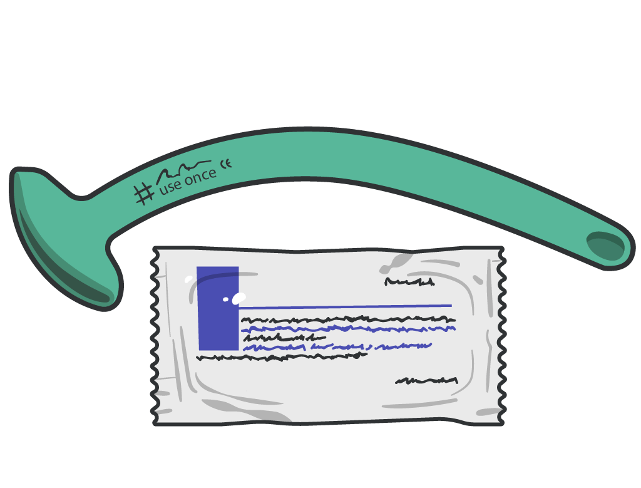
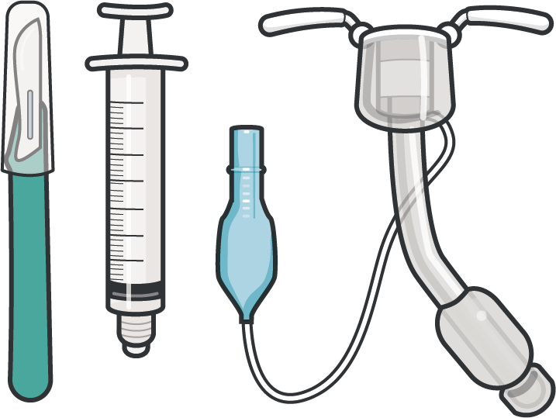
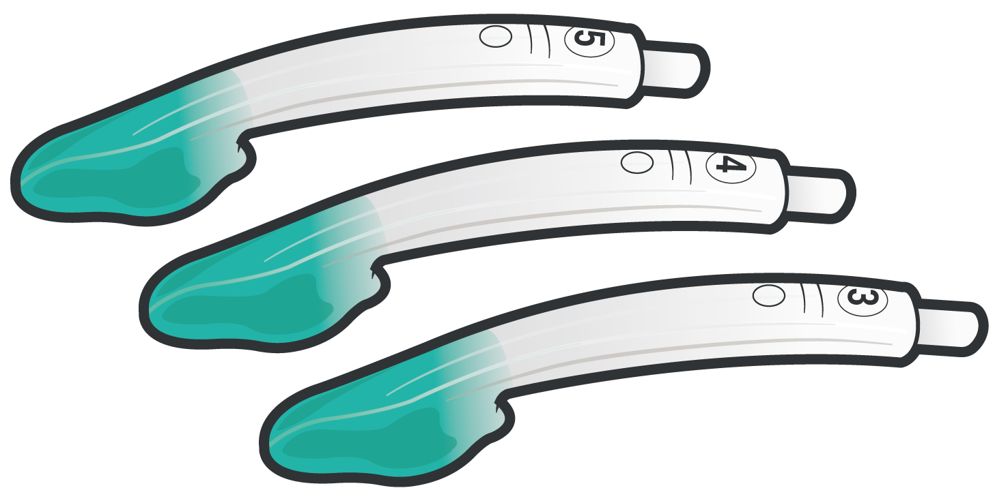
AIRWAY CONTROL EQUIPMENT
A
NASOPHARYNGEAL AIRWAY (NPA)
Nonsterile rubber tube-shaped device inserted into the casualty’s nostril
EXTRAGLOTTIC AIRWAY (EGA)
Used to establish an airway for oxygenation and ventilation without entering the trachea
CRICOTHYROIDOTOMY KIT
An advanced surgical airway used when other airway adjuncts have failed, as well as an airway obstruction or pending airway obstruction

Slide 14


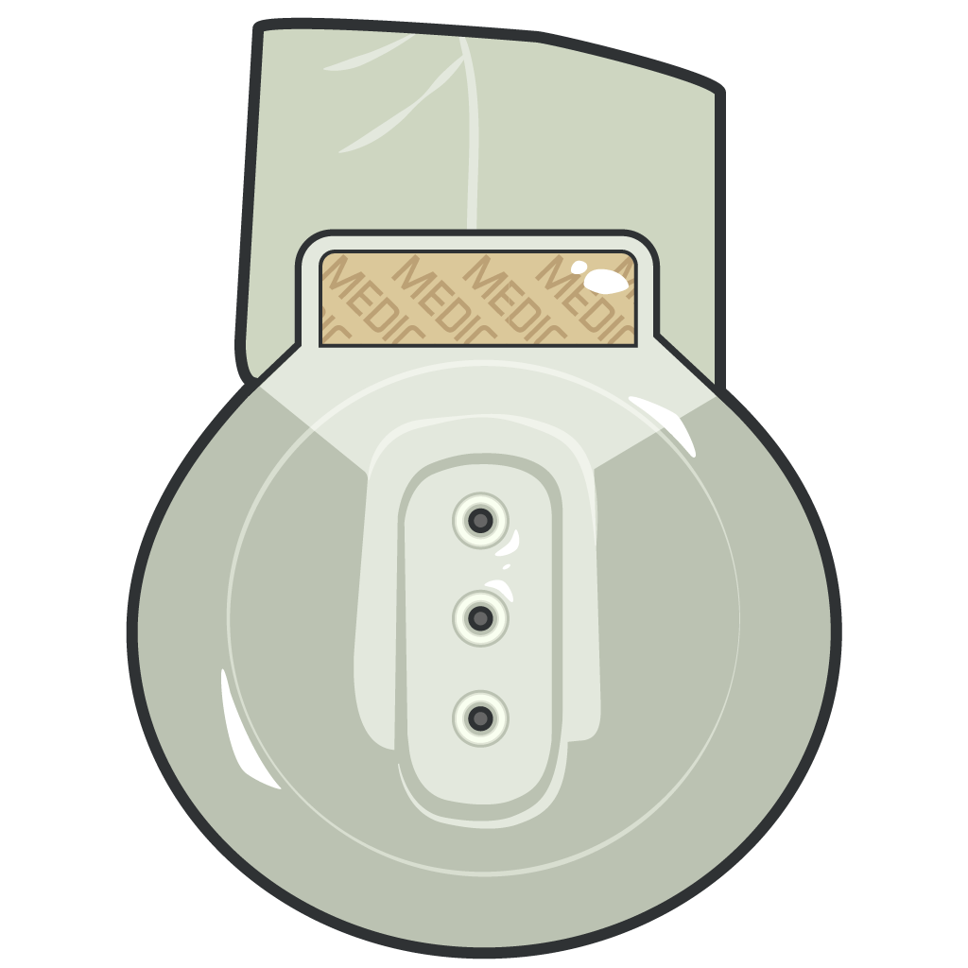
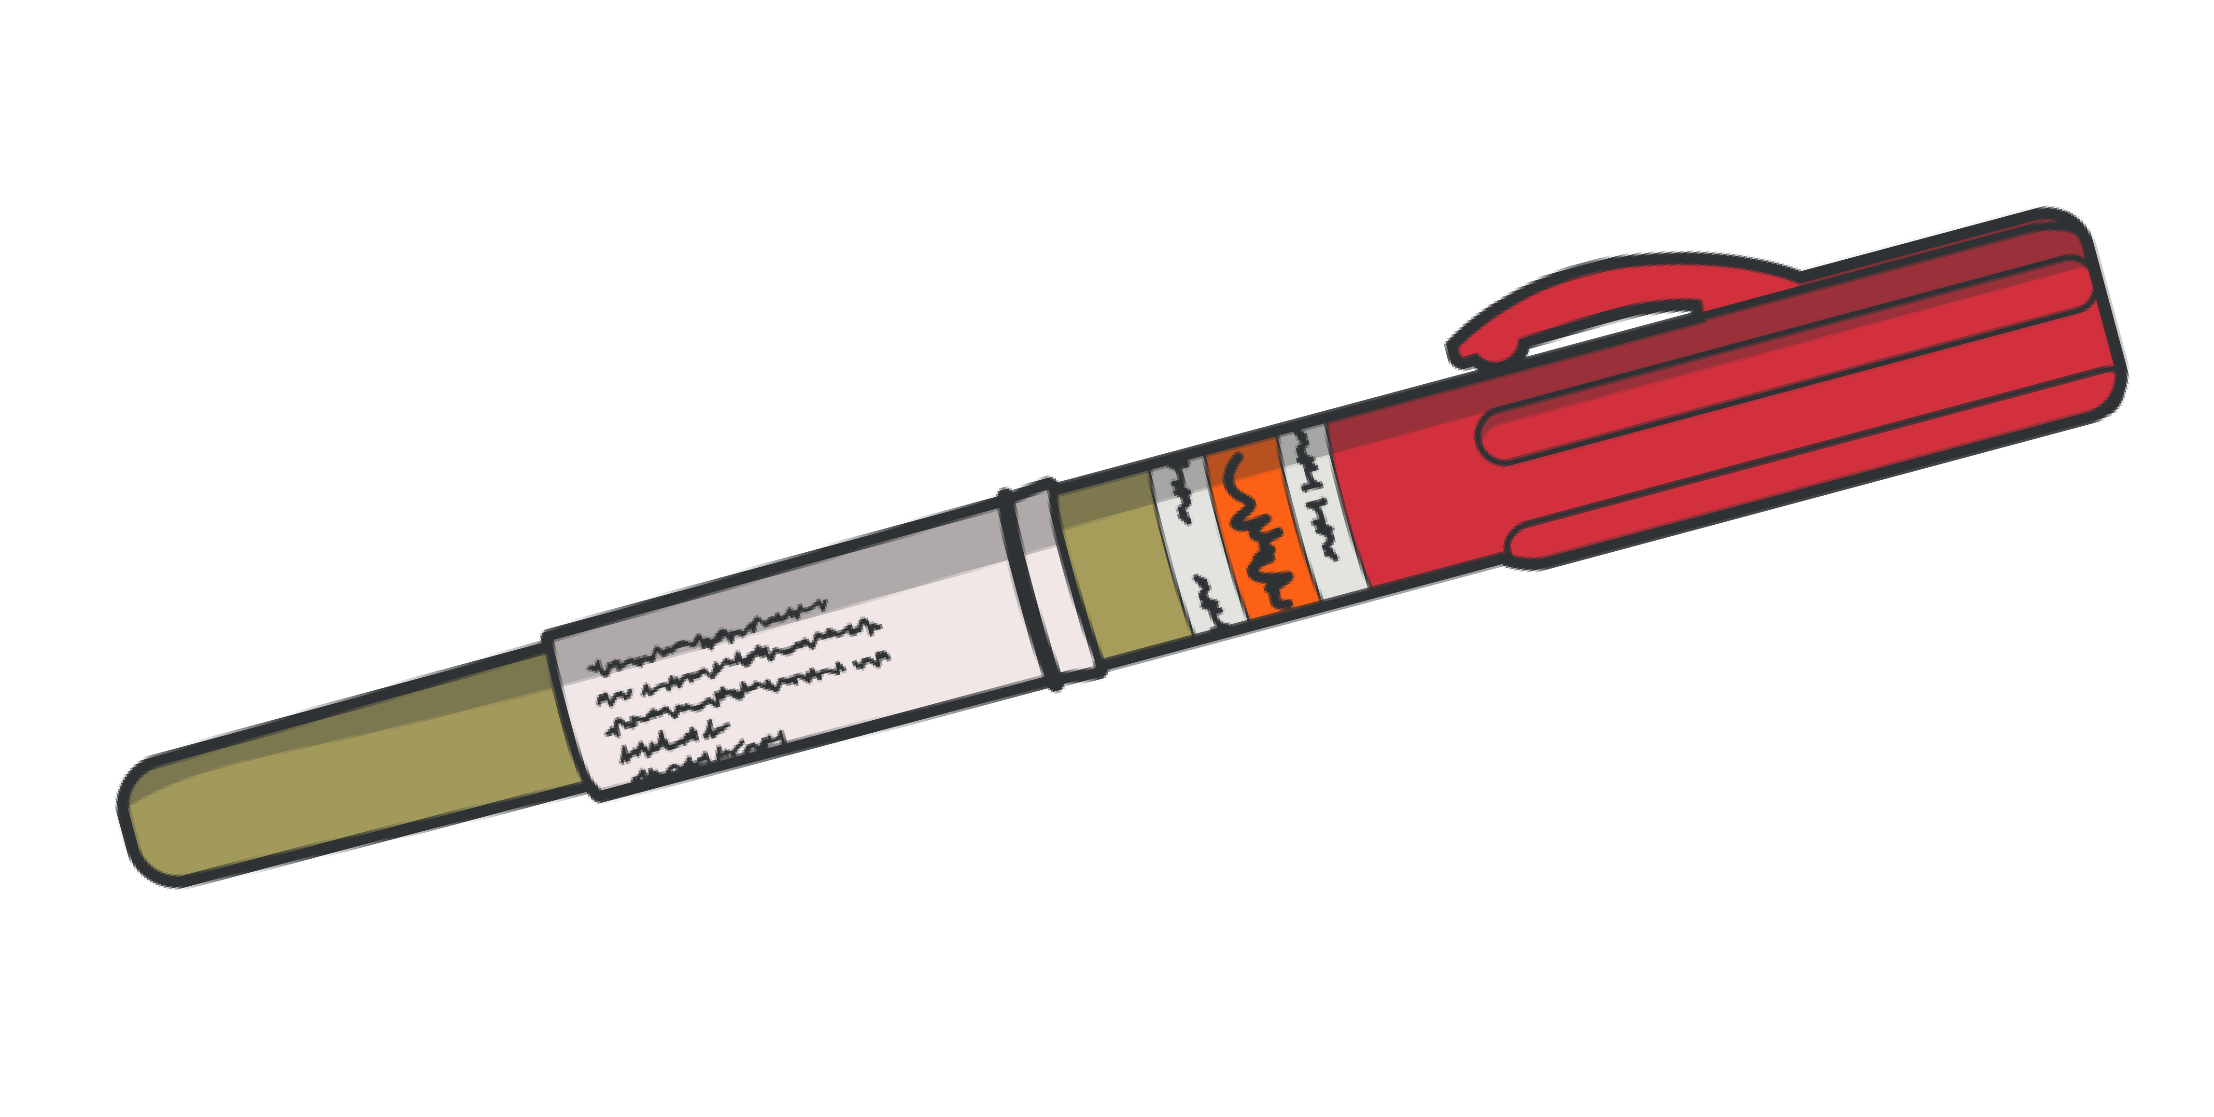
RESPIRATION SUPPORT EQUIPMENT
R
BAG VALVE MASK (BVM)
Provides positive pressure ventilations to a patient who is inadequately breathing or not breathing at all
VENTED CHEST SEAL
Vented and adhesive chest seal for treating penetrating chest wounds
10-14 GAUGE 3.25” NEEDLE CATHETER
Catheter-over-needle device inserted into the chest to treat tension pneumothorax

Slide 15
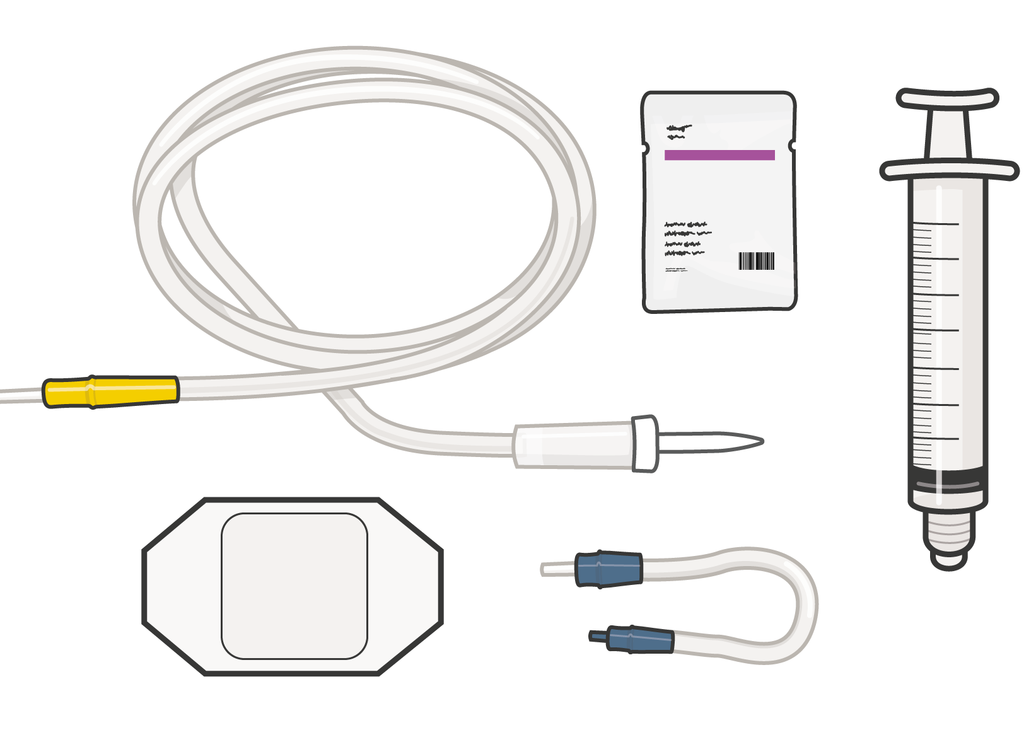



CIRCULATION
(cont.)
C
PELVIC
COMPRESSION DEVICE
Designed to compress a pelvis fracture, providing stability and preventing ongoing hemorrhage
INTRAVENOUS (IV) ACCESS KIT
The necessary supplies to establish intravenous access
INTRAOSSEOUS (IO) ACCESS EQUIPMENT
Equipment necessary to establish sternal, humeral, or tibial intraosseous access

Slide 16
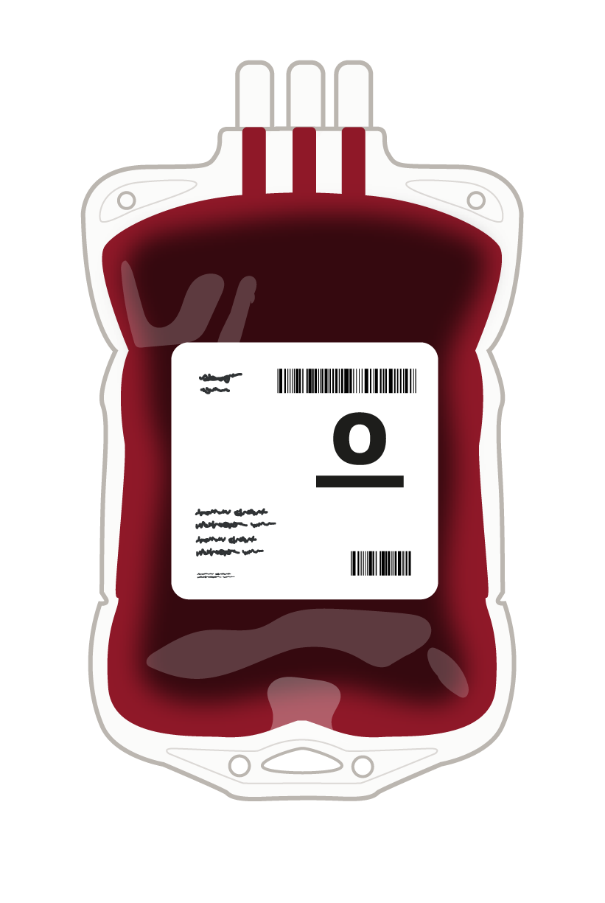
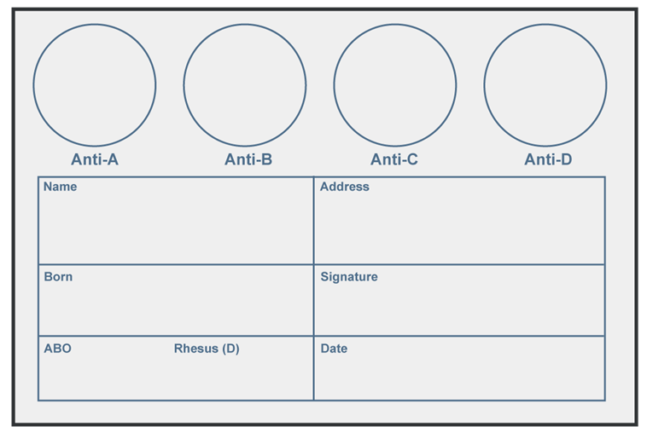
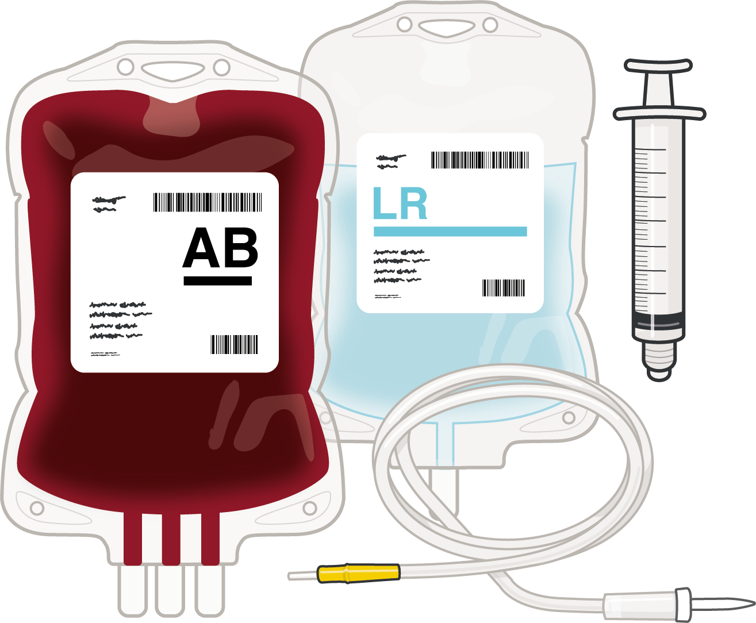


CIRCULATION
C
ELDONCARD™
A card used to determine blood type
TXA
Tranexamic acid – to help the casualty’s blood clotting process
BLOOD PRODUCTS, IV
FLUIDS, and Calcium
Blood products and fluids – to replace casualty losses due to hemorrhage

Slide 17
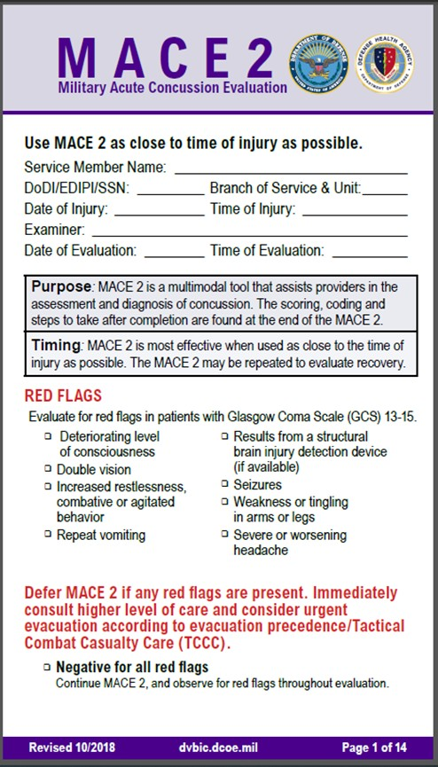

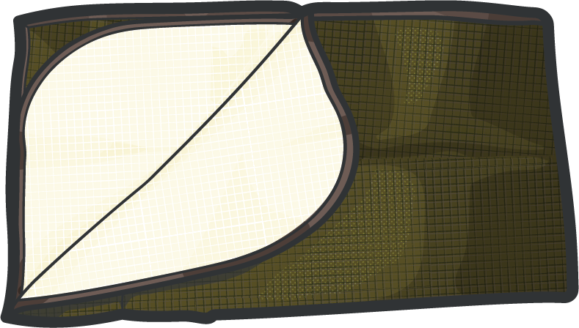
HYPOTHERMIA AND HEAD INJURY
H
ACTIVE PASSIVE
ACTIVE/PASSIVE HYPOTHERMIA KITS/BLANKETS
Used to prevent and manage hypothermia
MILITARY ACUTE CONCUSSION EVALUATION (MACE 2)
Used to identify possible traumatic brain injury (TBI)
NOTE: DD Form 1380 is also used in AVPU (alert, verbal, pain, unresponsive) assessment as part of head injury documentation

Slide 18
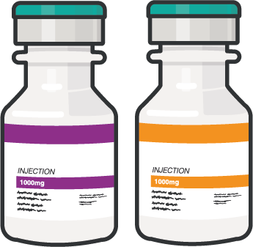
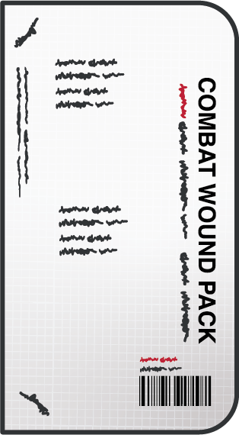
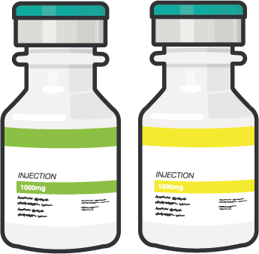
PAIN and
ANTIBIOTIC MEDICATIONS
P A
COMBAT WOUND PACK
Moxifloxacin 400 mg tablet once daily
Meloxicam 15 mg tablet once daily
Acetaminophen x2 500mg tablet every 8 hours
PAIN MEDICATIONS
For pain not controlled by the CWMP, other pain medications that can be administered by many different routes are available.
ANTIBIOTICS
If time and situation allow, IV antibiotics can be administered, if indicated.

Slide 19
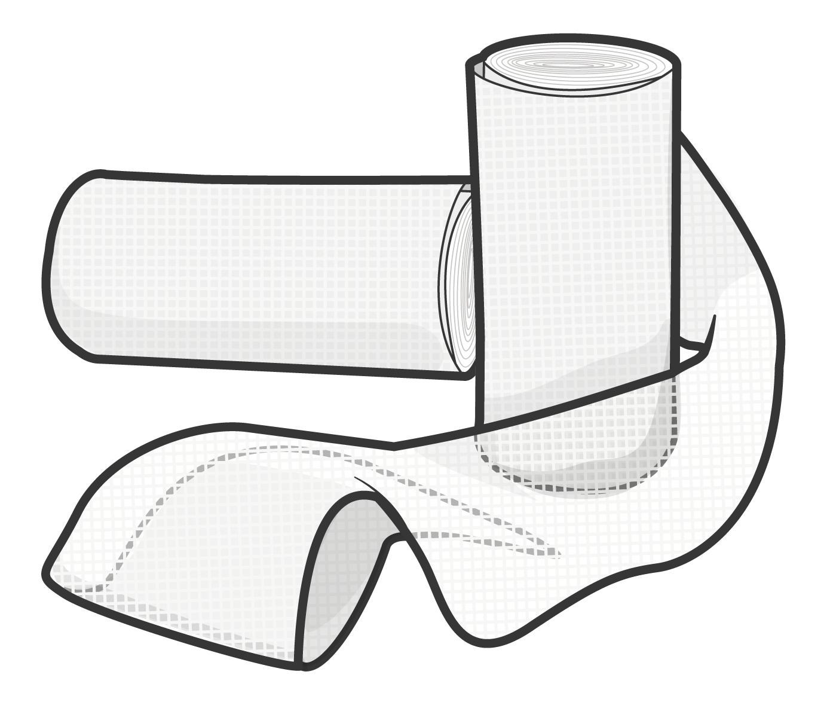
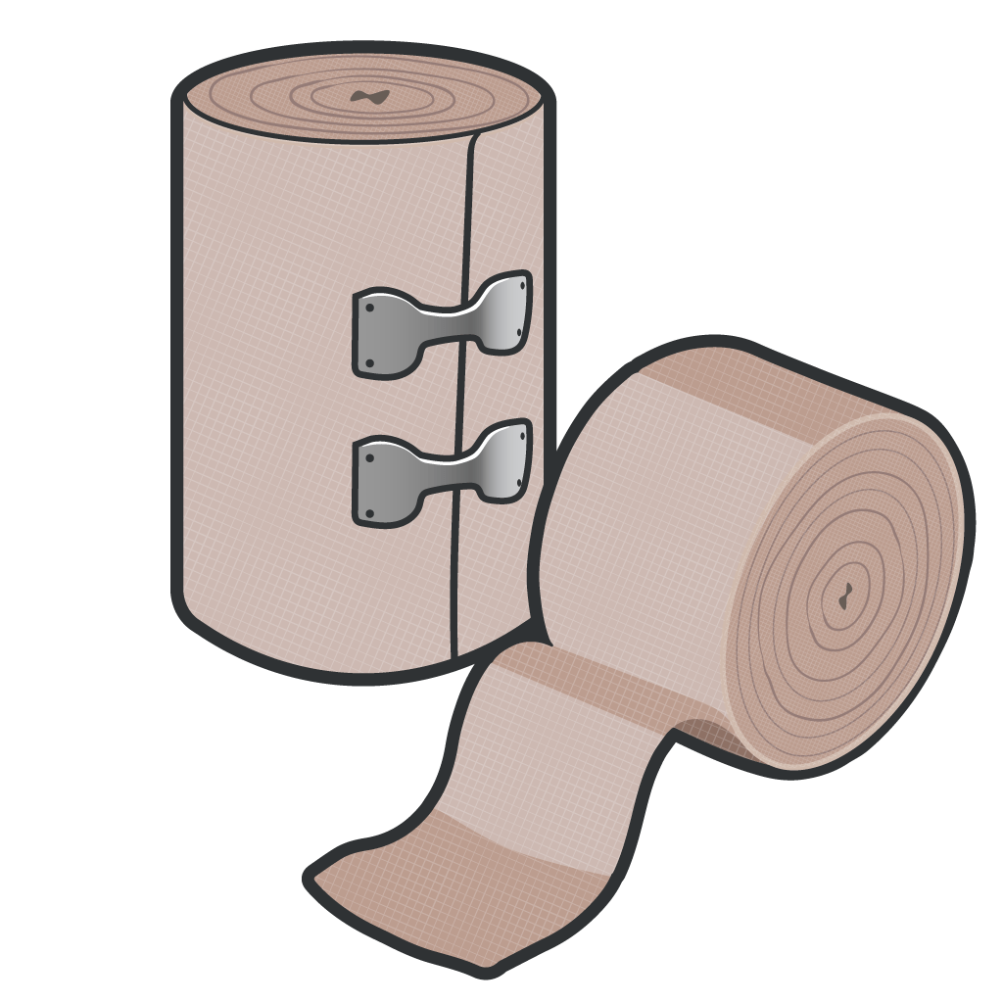
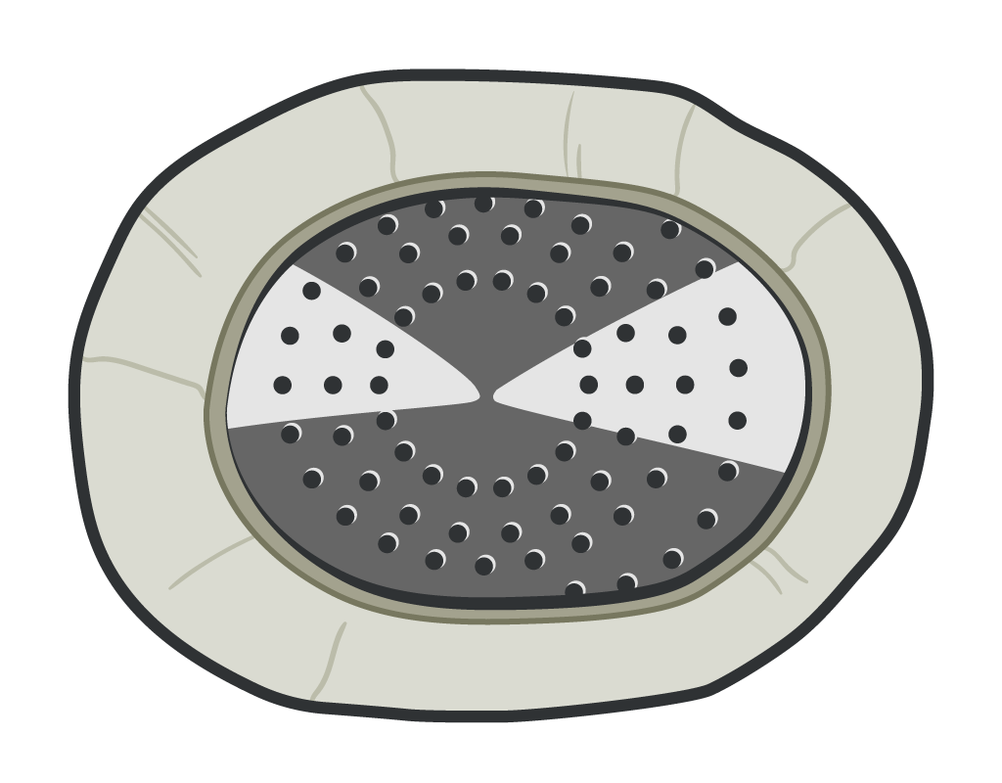
WOUND MANAGEMENT
W
GAUZE
Gauze rolls used to stop minor bleeding or as bulky material for wound packing
ELASTIC WRAP
Stretchable cloth like wrap used to hold medical different types of medical intervention equipment in place
RIGID EYE SHIELD
A shield that provides domed protection of the eye WITHOUT applying pressure

Slide 20
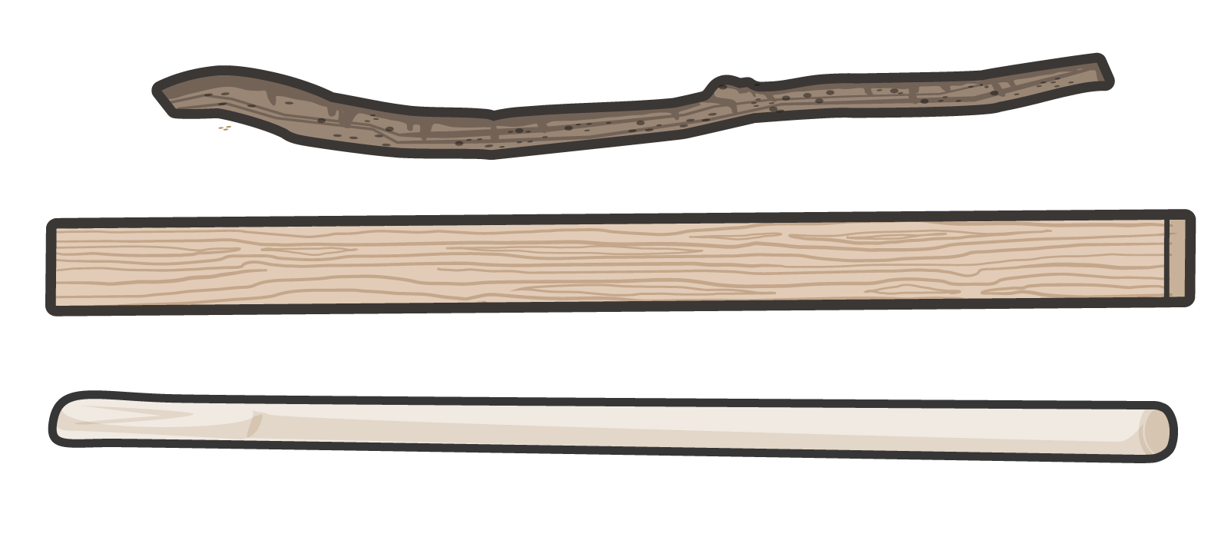
SPLINTS
S
MALLEABLE SPLINTING
Semi-rigid material used to immobilize an injured limb
RIGID SPLINTING
Rigid splinting material that stabilizes the limb and protects the injury

Slide 21
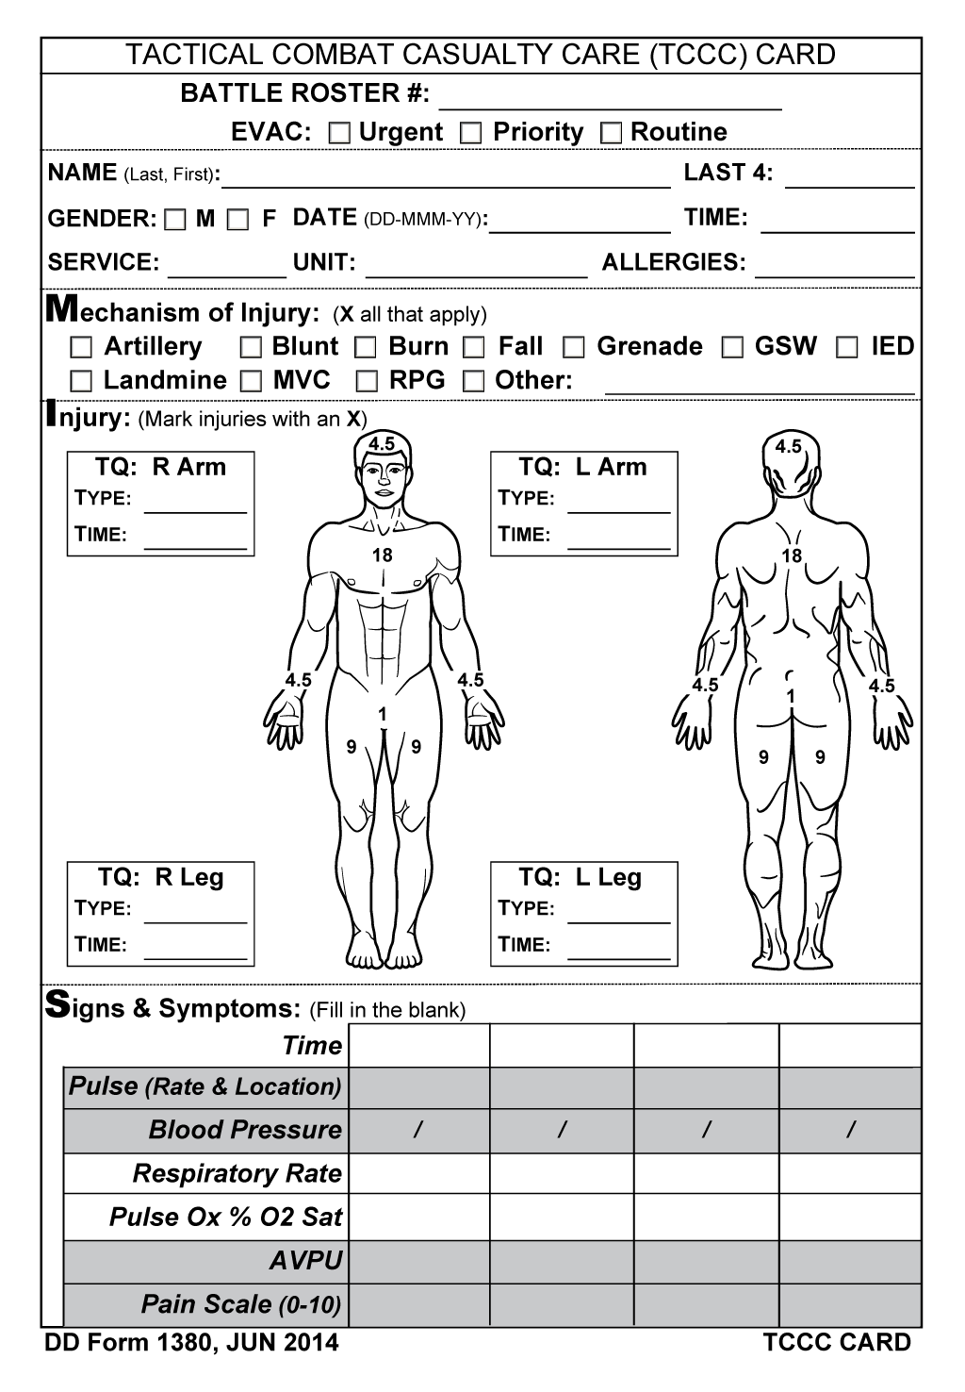
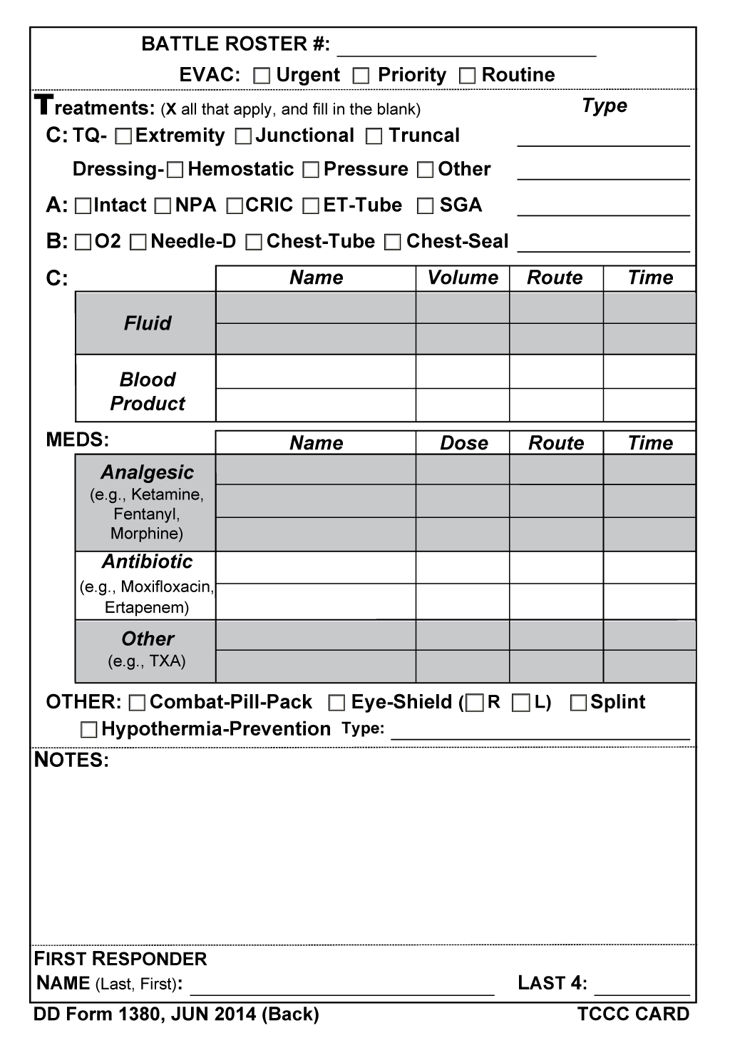
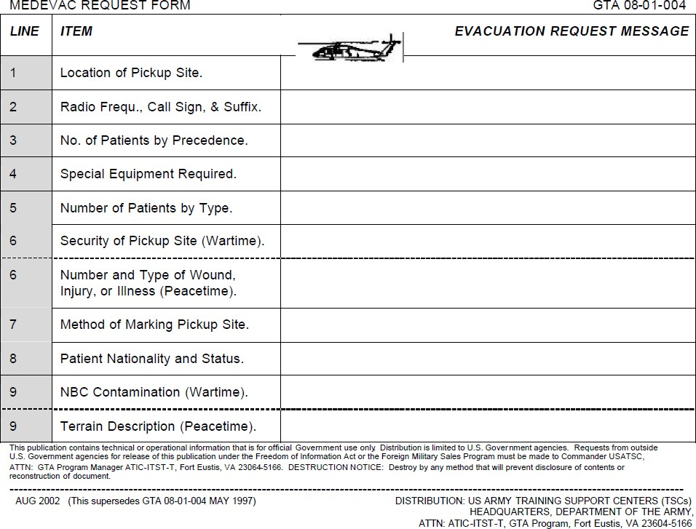
DOCUMENTATION/MEDEVAC
FRONT
BACK
DD Form 1380 TCCC CARD
DoD-approved standard for documenting ALL assessment and treatment provided to casualties before evacuation or handoff to other medical personnel
9-LINE MEDEVAC (ARMY Example)
Call procedure that is divided into nine lines of information for evacuation crews

Slide 22
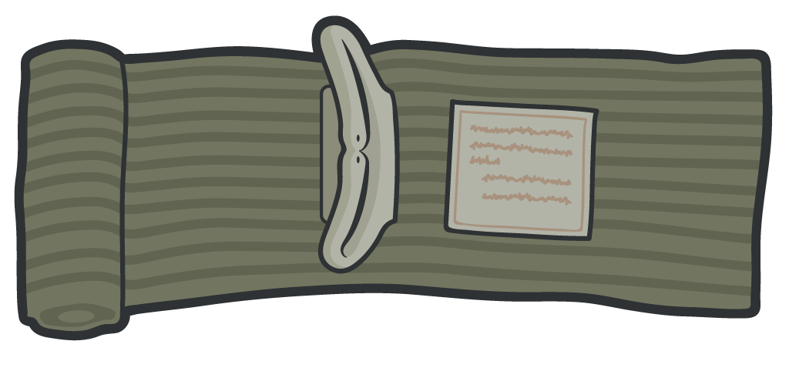
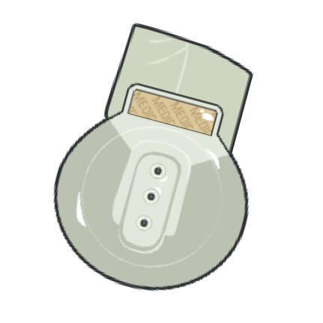
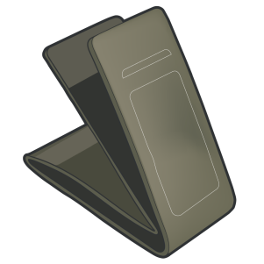
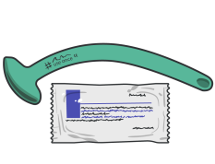
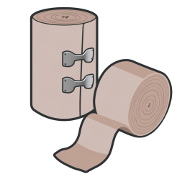



MAINTENANCE AND RESUPPLY
REMEMBER:
Regularly inspect your JFAK, CLS bag, CMC bag,
and other Service-specific medical kits
BEFORE DURING AFTER
ALL training events and missions

Slide 23

CAT QUICK LAUNCH CONFIGURATION VIDEO
Video can be found on deployedmedicine.com

Slide 24
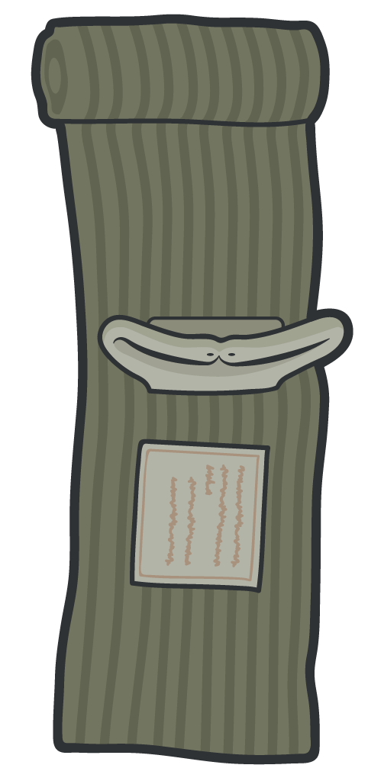
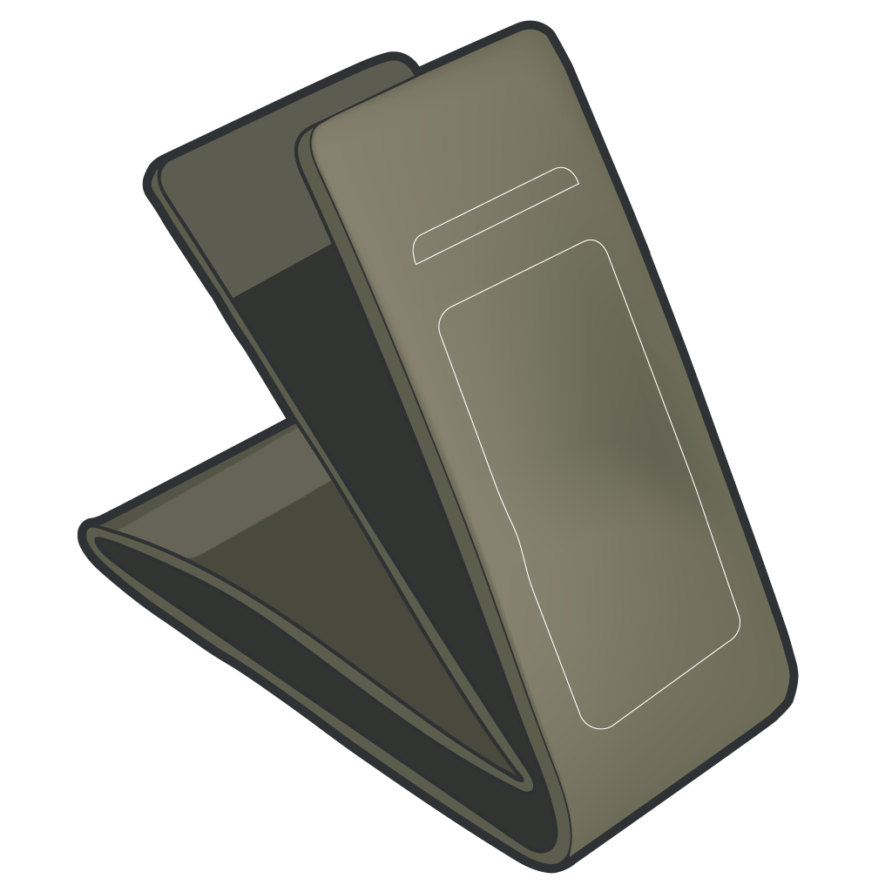

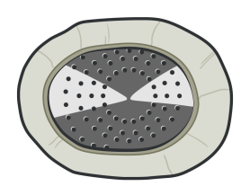
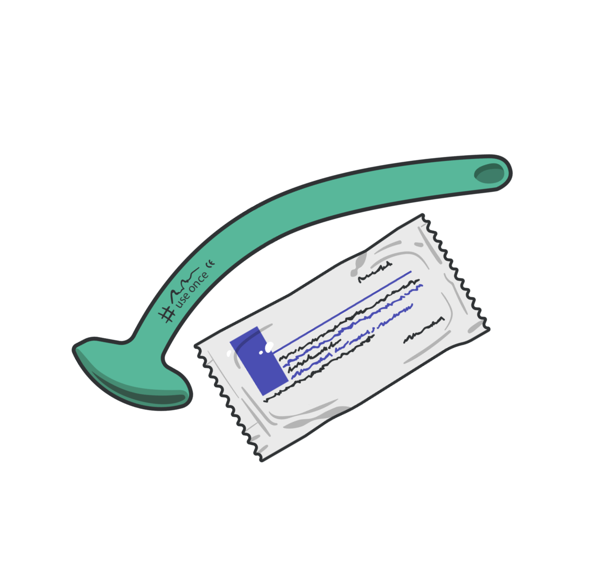

MAINTENANCE AND RESUPPLY
(cont.)
Check to be sure all required equipment is in your Service specific kits and bags
Check seals and wrappers
REPLACE items with broken or unsealed wrappers
Check expiration dates
REPLACE if expired or the expiration date DOES NOT
exceed your expected deployment timeframe
DO NOT USE EQUIPMENT THAT IS NOT CoTCCC APPROVED
DO NOT DEPLOY WITH MISSING, PREVIOUSLY USED FOR TRAINING, OR EXPIRED EQUIPMENT

Slide 25
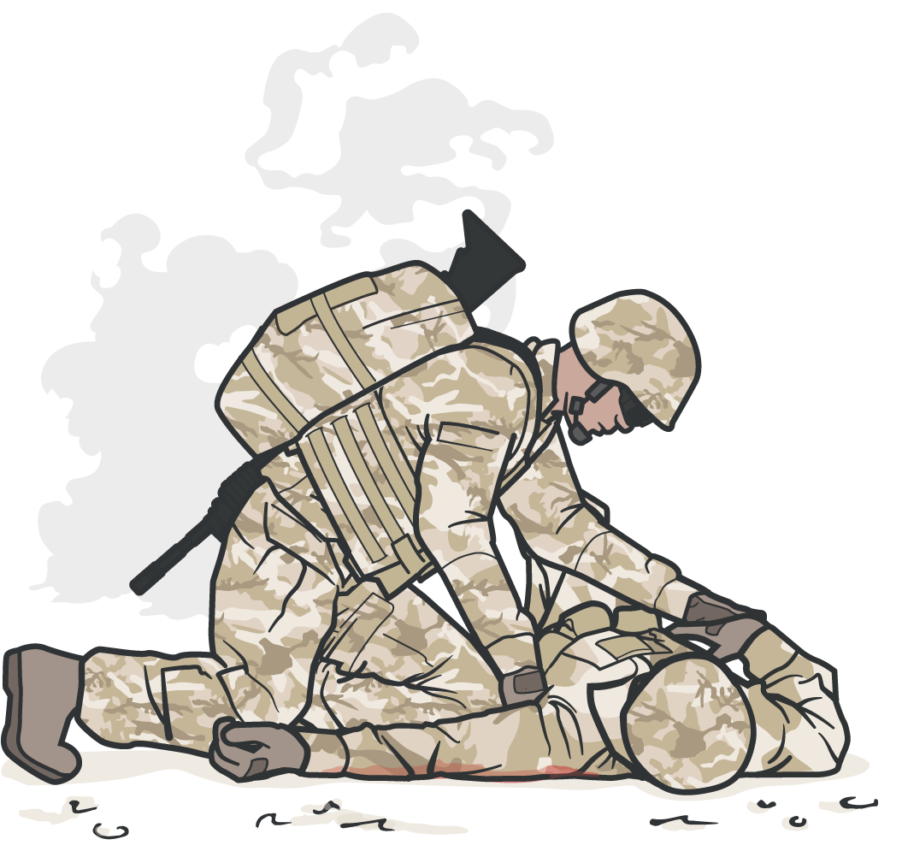
OTHER CONSIDERATIONS
TRAIN on the equipment you will use
PREPARE for mass casualties by triaging and staging your medical equipment
EVENLY DISTRIBUTE equipment amongst the unit
TRAIN with a completely stocked CMC bag to help simulate the deployed environment

Slide 26

OTHER CONSIDERATIONS
Beware of UNAPPROVED EQUIPMENT
Beware of FAKE EQUIPMENT
Check unit-specific evacuation equipment

Slide 27
SUMMARY
Know the basic contents of JFAKs, CLS bags, and CMC bags
Understand how the equipment in each kit and bag supports delivery of TCCC
Maintain and as needed, replace equipment before deploying
Describe proper usage and implementation of DD 1380 TCCC Card and 9-Line MEDEVAC Card
TRAIN, TRAIN, TRAIN!!!
Check your durable (non-disposable) equipment to make sure that it works after repeated training

Slide 28



CHECK ON LEARNING
What type of tourniquet found in the CMC Aid Bag is used to control massive hemorrhage in the axilla that is too proximal for effective limb tourniquet application?
When should you inspect your JFAK, CLS bag, CMC bag and other Service-specific medical kits?

Slide 29



ANY QUESTIONS?

Slide 30
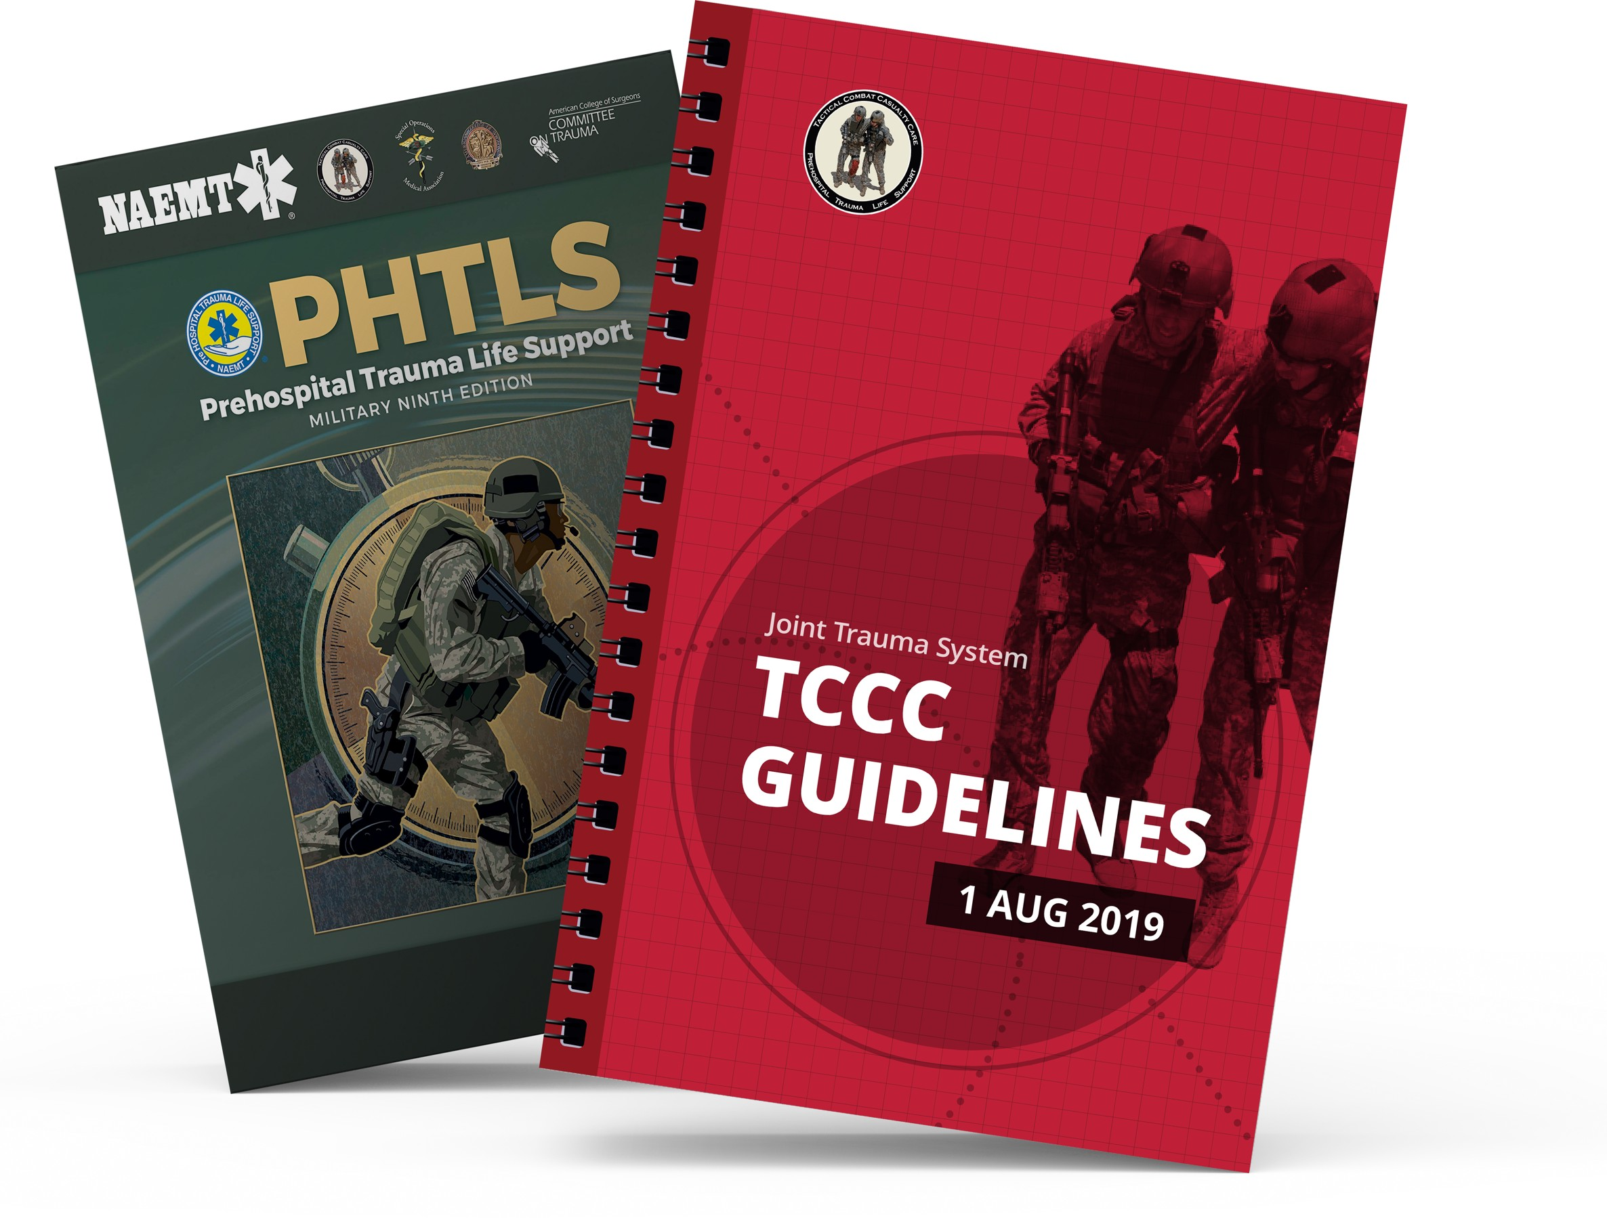
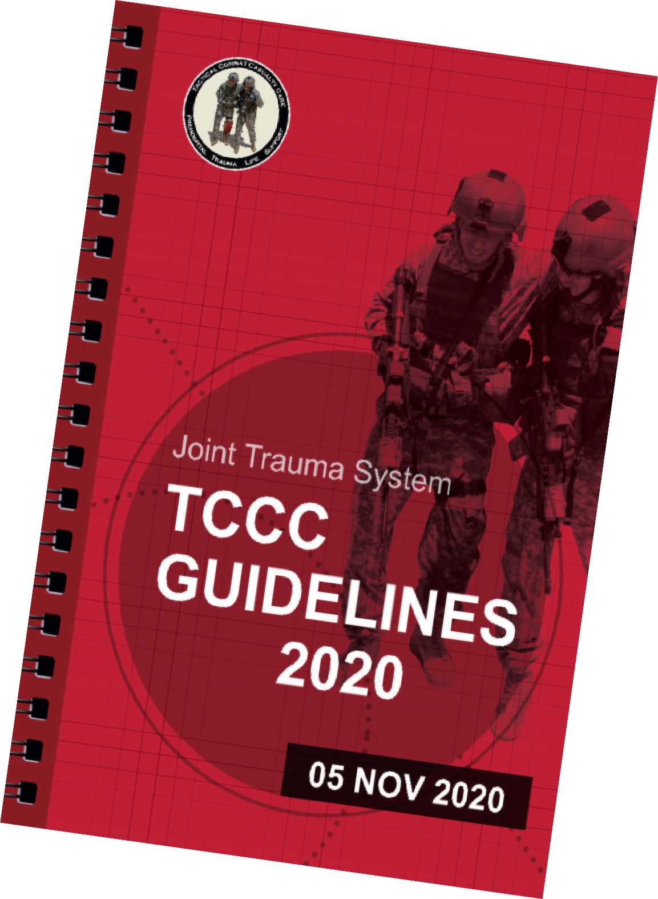
REFERENCES
TCCC: Guidelines
by JTS/CoTCCC
The latest edition is dated 05 November 2020. These guidelines, updated regularly, are the result of decisions made by CoTCCC in exploring evidence-based research on best practices.
PHTLS: Military Edition
by NAEMT
Prehospital Trauma Life Support (PHTLS), Military Edition, teaches and reinforces the principles of rapidly assessing a trauma patient using an orderly approach.

